Slide 1



ConGreat
HackZurich 2022 – challenge #12

Slide 2
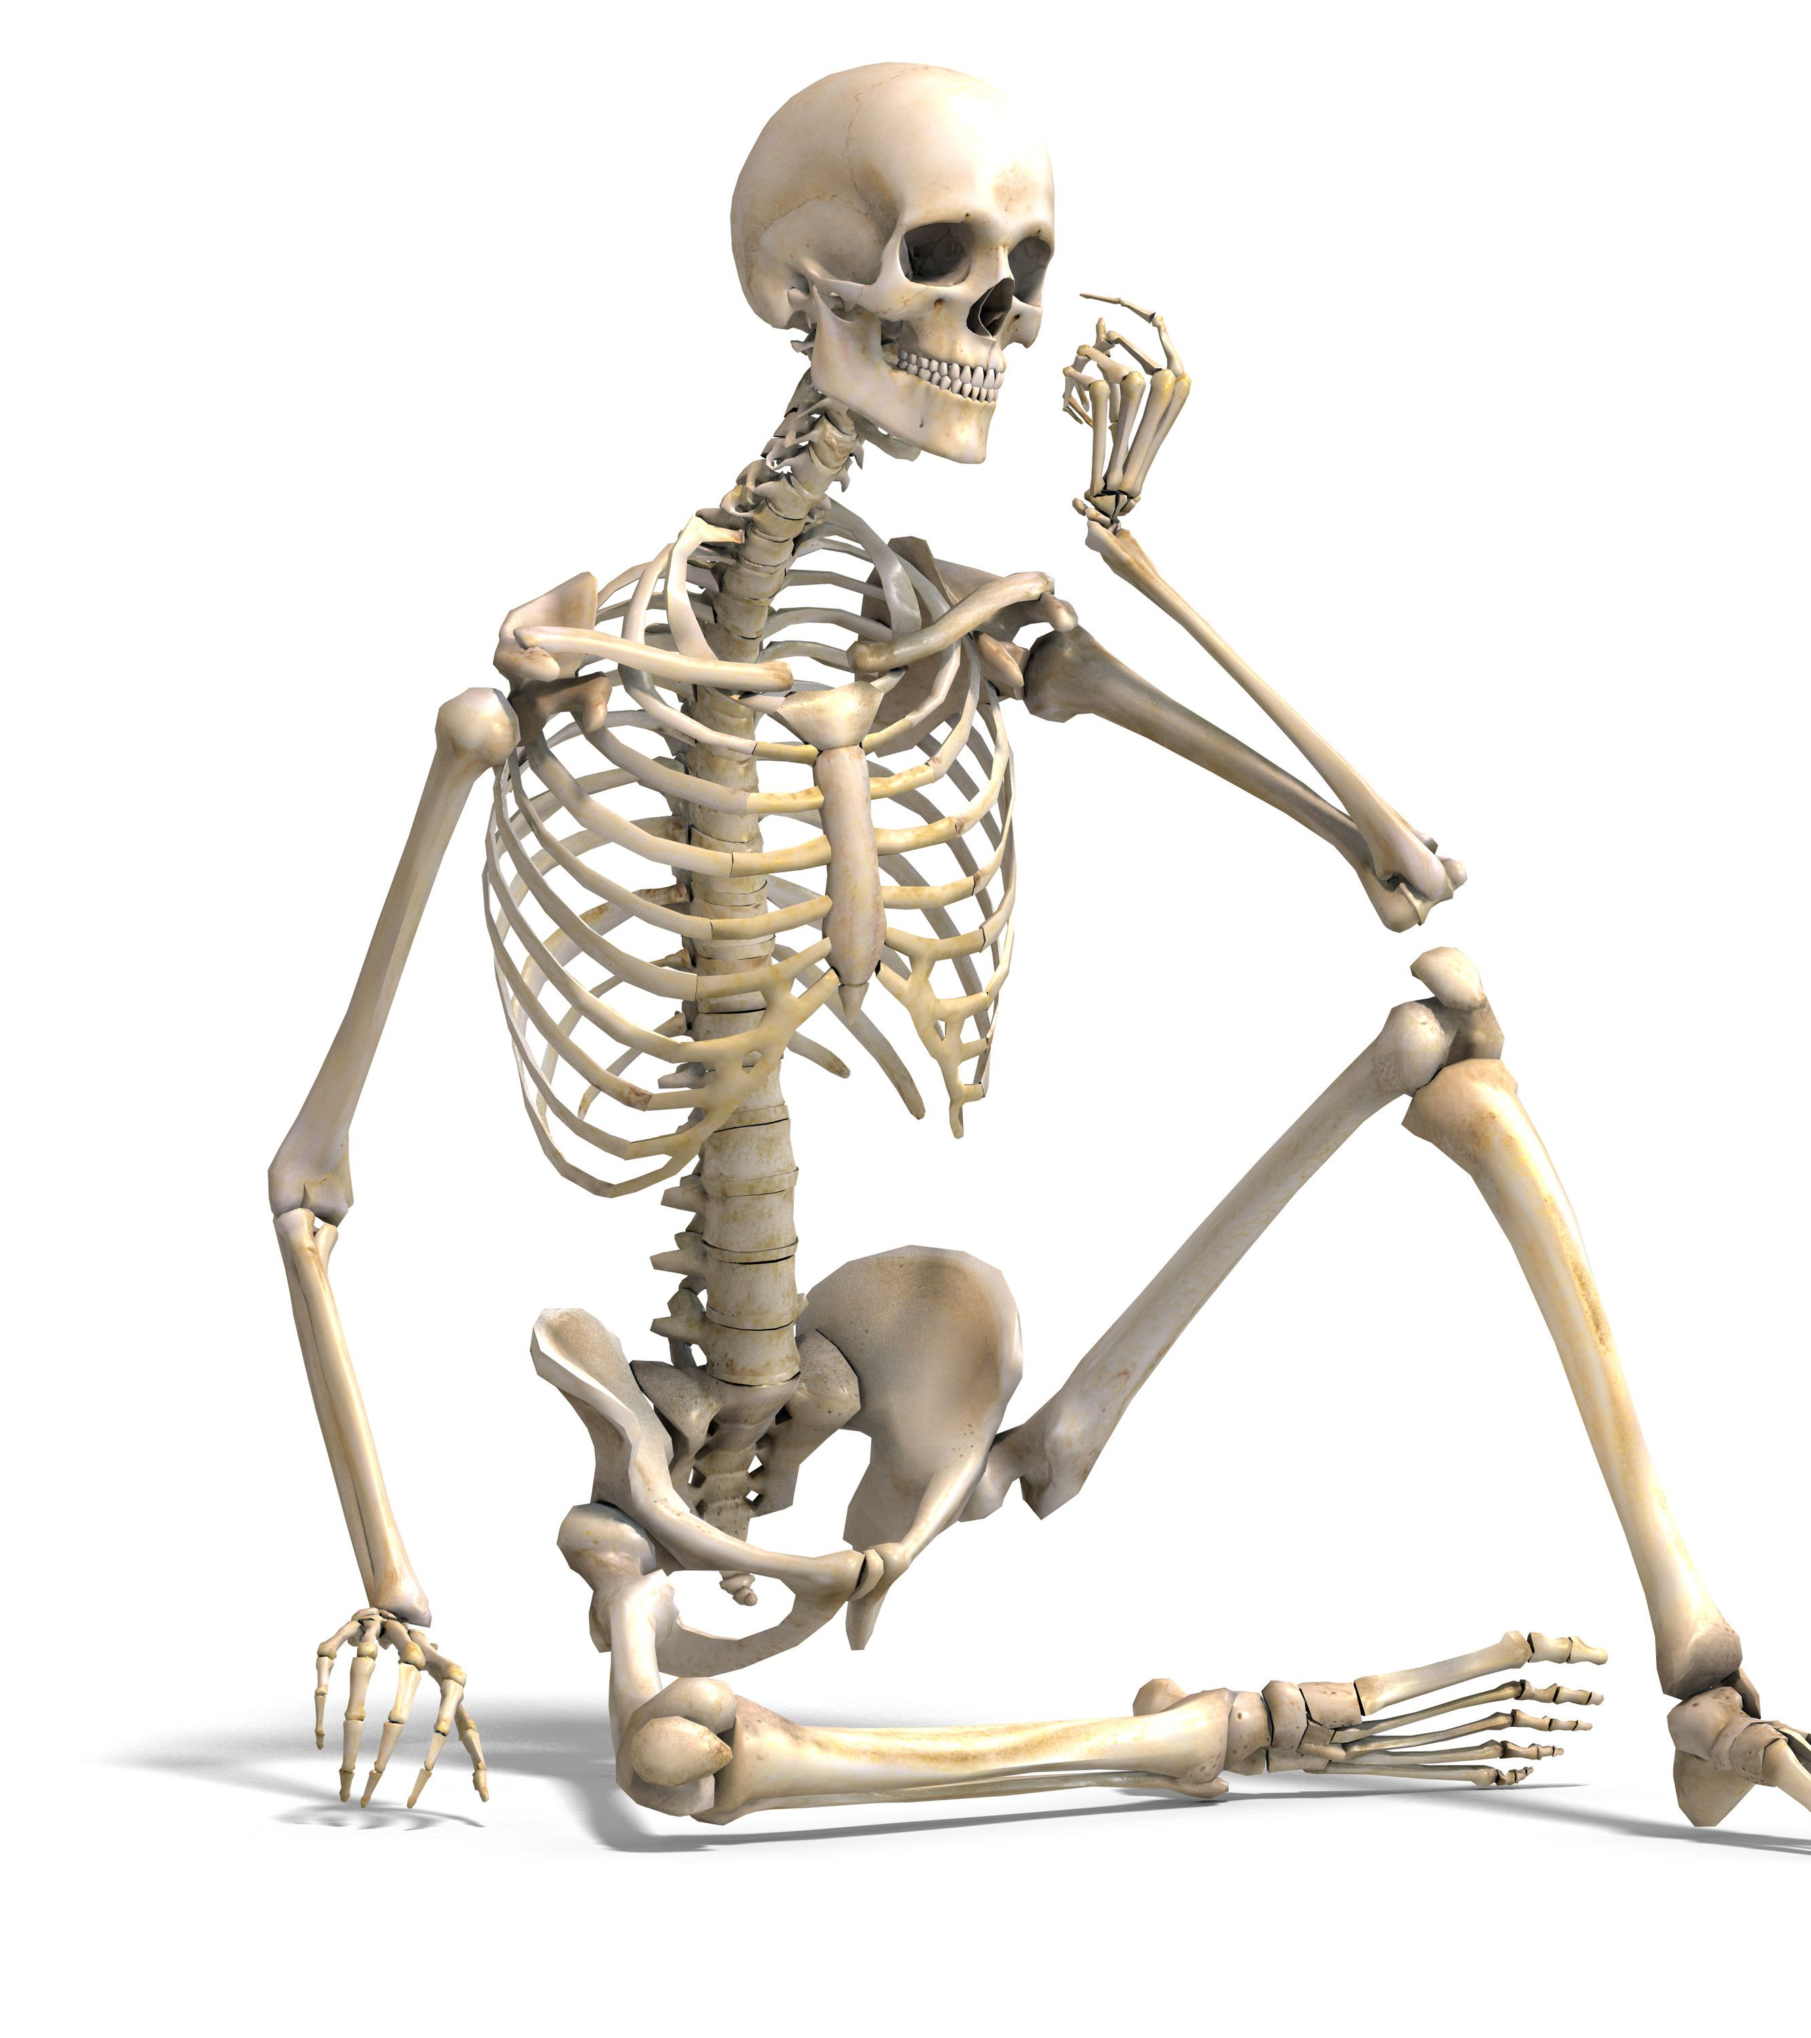
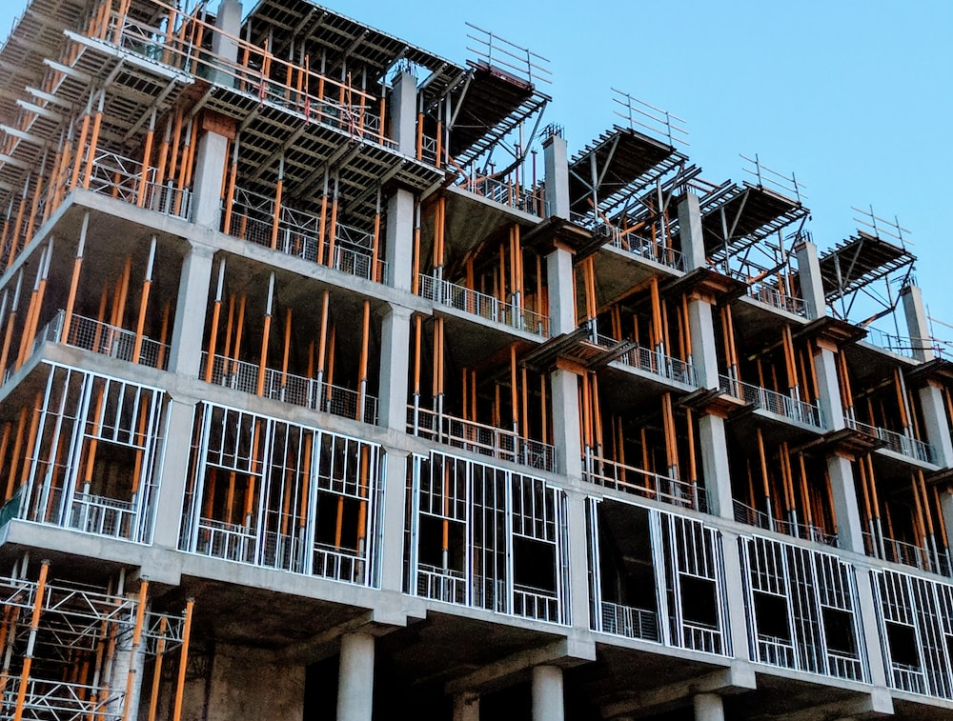
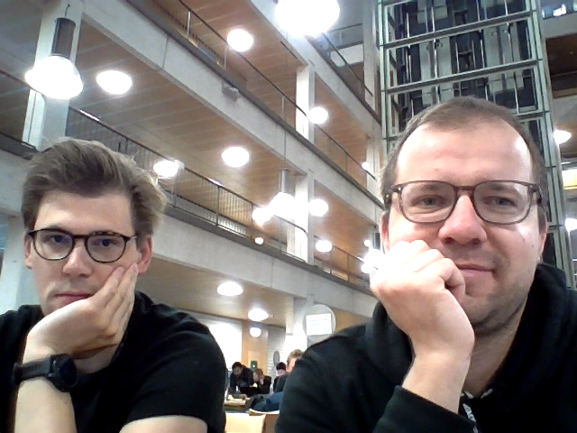
Your body – What would you build first?

Slide 3
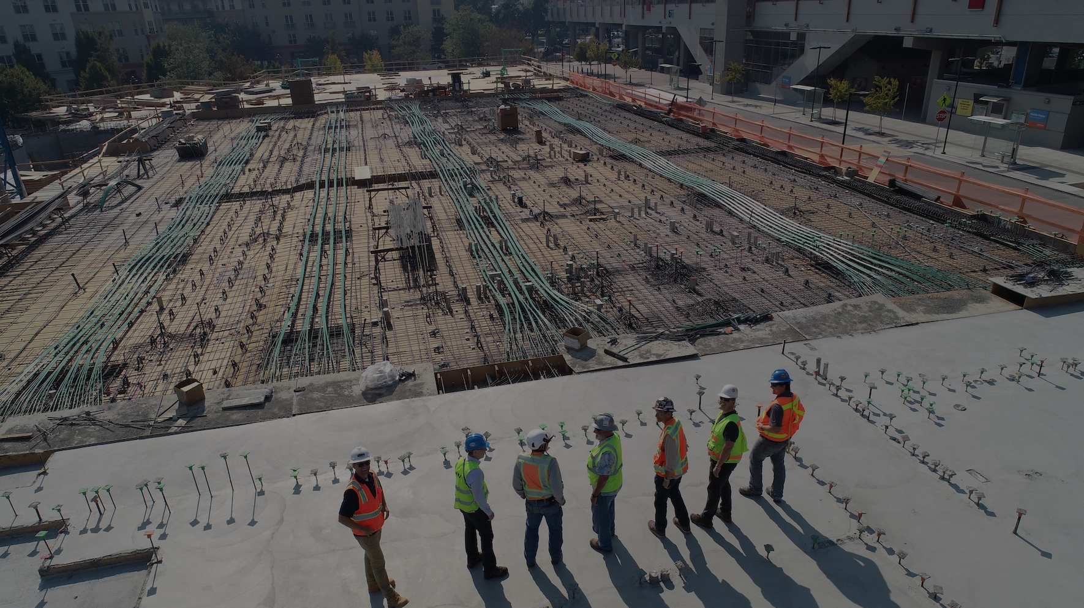
Our solution
AI-powered sensor-fed concrete pouring scheduling technology

Slide 4

PREDICTIONS = past data + future forecasts

Slide 5
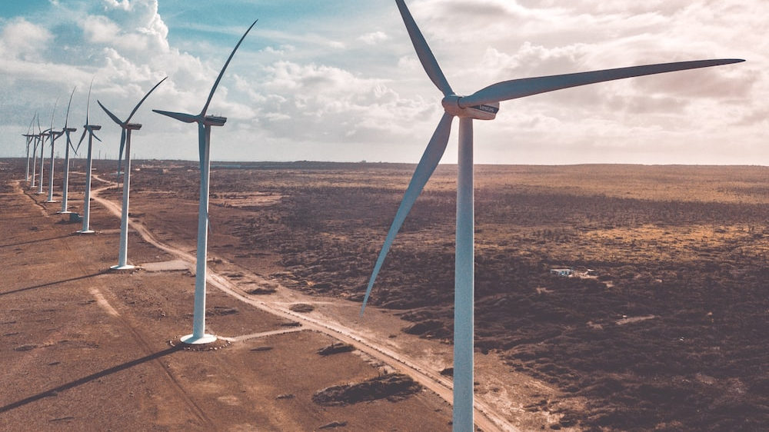
CO2 emission reduced by 8%

Slide 6
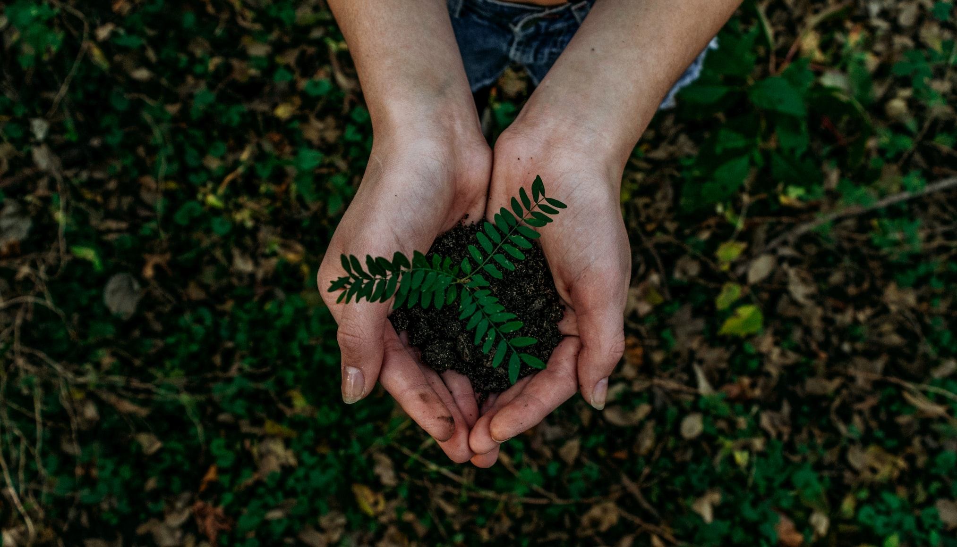
For our children and grandchildren…
…for a more sustainable future

